Slide 1
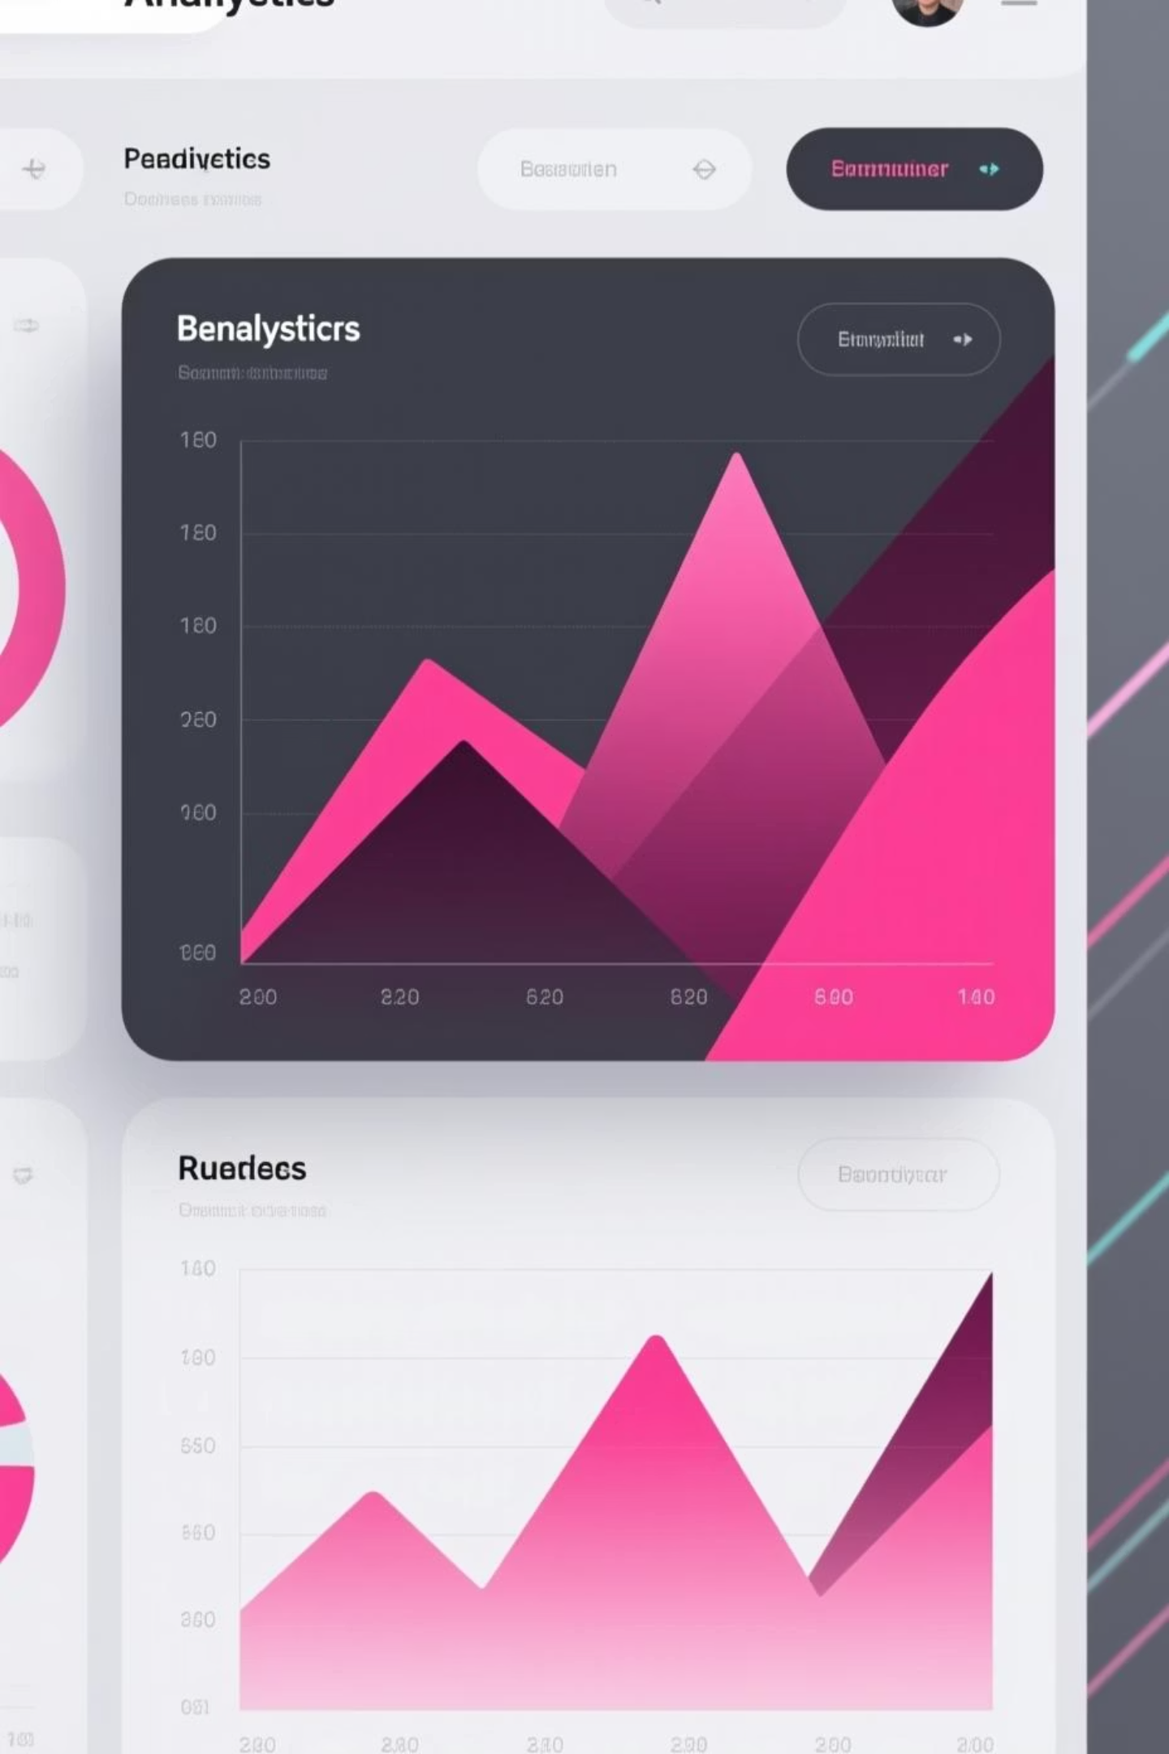
Customer Shopping Behavior Analysis
Analyzing 3,900 purchases to uncover insights into spending patterns, customer segments, and product preferences that drive strategic business decisions.

Slide 2
Dataset Overview
3,900
18
$59.76
3.75
Total Purchases
Data Points
Avg Purchase
Avg Rating
Transactions analyzed across all categories
Features tracking demographics and behavior
Mean transaction value per customer
Customer satisfaction score
Customer Data
Transaction Details
Age, Gender, Location
Product, Category, Amount
Subscription Status
Discounts & Promotions
Purchase History
Shipping & Reviews

Slide 3

Data Preparation Process
01
02
Data Loading & Exploration
Cleaning & Standardization
Imported dataset using pandas, analyzed structure with df.info() and summary statistics
Handled 37 missing review ratings using median imputation, standardized columns to snake case
03
04
Feature Engineering
Database Integration
Created age_group bins and purchase_frequency_days, removed redundant promo_code_used column
Connected to PostgreSQL and loaded cleaned data for advanced SQL analysis

Slide 4
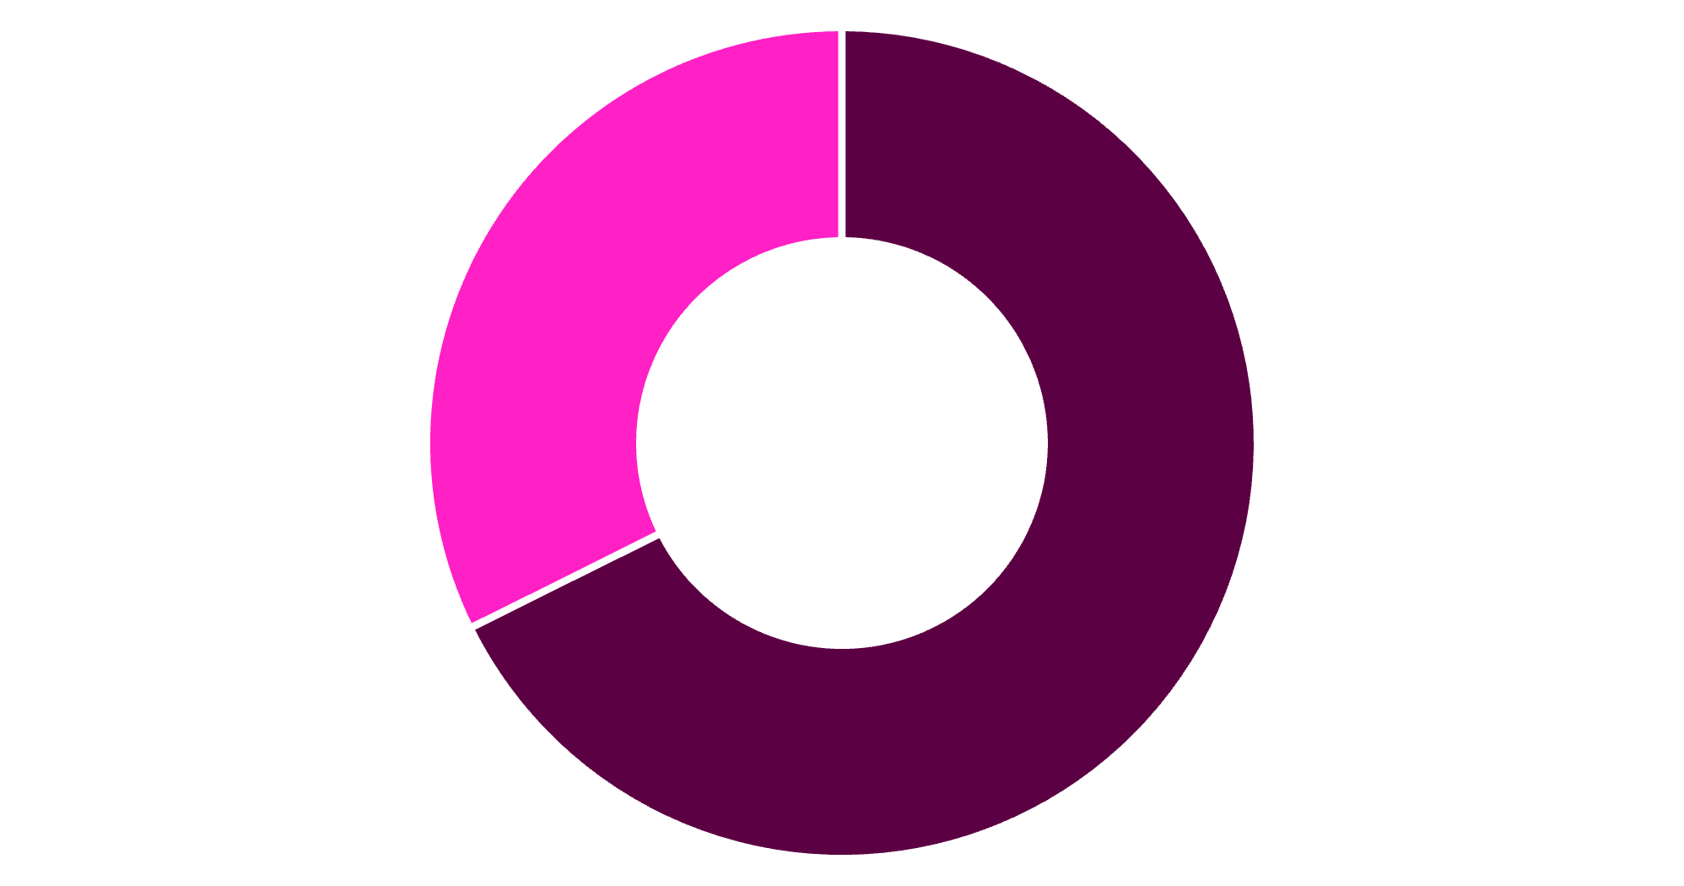
Revenue Insights by Gender
Male Customers Drive Revenue
Male customers generate $157,890 in total revenue compared to $75,191 from female customers, representing 68% of total sales.
This significant gap suggests opportunities for targeted marketing to female demographics.
Male
Female

Slide 5

Product Performance Analysis
Top-Rated Products
Discount-Dependent Items
Gloves - 3.86 rating
Sandals - 3.84 rating
Hat - 50% discount rate
Boots - 3.82 rating
Sneakers - 49.66%
Hat - 3.80 rating
Coat - 49.07%
Skirt - 3.78 rating
Sweater - 48.17%
Pants - 47.37%

Slide 6



Customer Segmentation
New
1
83 customers
Returning
2
701 customers
Loyal
3
3,116 customers
The majority of our customer base (80%) falls into the Loyal segment, indicating strong retention. However, only 2% are new customers, suggesting a need for acquisition strategies.

Slide 7


Subscription Analysis
Subscription Impact
1,053 subscribers generate $62,645 with $59.49 average spend
2,847 non-subscribers generate $170,436 with $59.87 average spend
27%
Among repeat buyers (>5 purchases), 958 are subscribers vs. 2,518 non-subscribers, showing subscription correlation with loyalty.
Subscribers
73%
Non-Subscribers

Slide 8
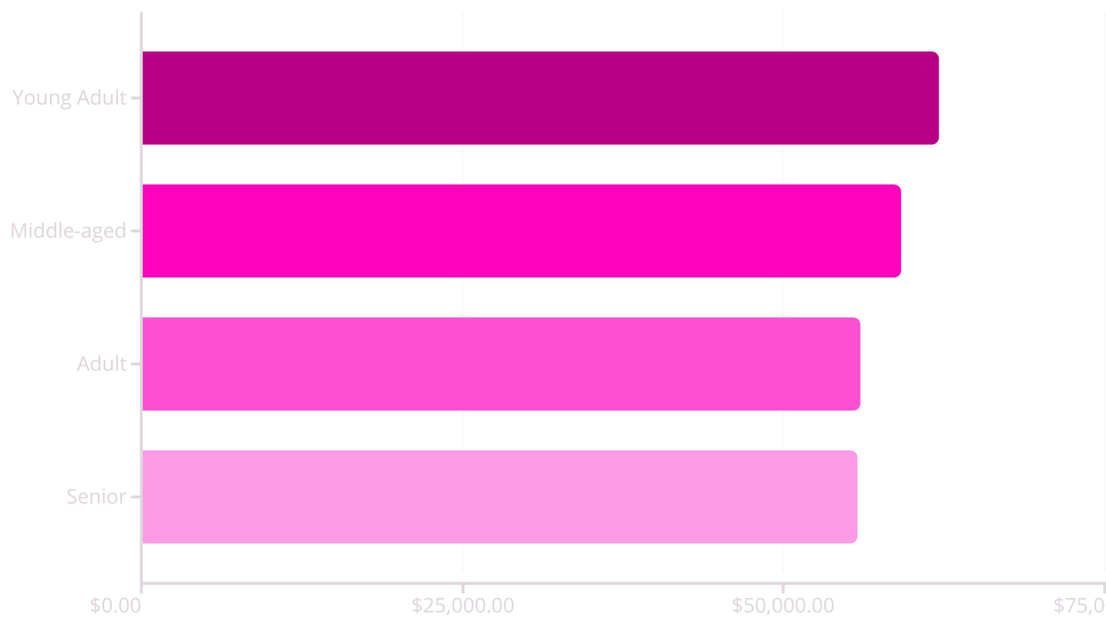
Revenue by Age Group
Young Adults lead revenue generation at $62,143, followed closely by Middle-aged customers. Revenue distribution is relatively balanced across age groups, indicating broad market appeal.

Slide 9

Shipping & Discount Insights
Express Shipping Premium
Express shipping customers spend $60.48 on average vs. $58.46 for standard shipping, indicating willingness to pay more.
Smart Discount Users
839 customers used discounts but still spent above the $59.76 average, showing discounts don't always reduce basket size.

Slide 10
Strategic Recommendations
Boost Subscriptions
Customer Loyalty Programs
Review Discount Policy
Promote exclusive benefits to convert the 73% non-subscriber base and increase recurring revenue.
Reward repeat buyers to accelerate movement from Returning to Loyal segments.
Balance promotional sales boosts with margin control, especially for discount-dependent products.
Product Positioning
Targeted Marketing
Highlight top-rated items (Gloves, Sandals, Boots) and best-sellers in marketing campaigns.
Focus efforts on Young Adults and express-shipping users who demonstrate higher spending potential.

